Slide 1
Modern Retrieval Evaluations
Hongning Wang
CS@UVa

Slide 2
What we have known about IR evaluations
Three key elements for IR evaluation
A document collection
A test suite of information needs
A set of relevance judgments
Evaluation of unranked retrieval sets
Precision/Recall
Evaluation of ranked retrieval sets
P@k, MAP, MRR, NDCG
Statistic significance
Avoid randomness in evaluation

Slide 3
Rethink retrieval evaluation
Goal of any IR system
Satisfying users’ information need
Core quality measure criterion
“how well a system meets the information needs of its users.” – wiki
Are traditional IR evaluations qualified for this purpose?
What is missing?

Slide 4
Do user preferences and evaluation measures line up? ^{[Sanderson et al. SIGIR’10]}
Research question
Does effectiveness measured on a test collection predict user preferences for one IR system over another?
If such predictive power exists, does the strength of prediction vary across different search tasks and topic types?
If present, does the predictive power vary when different effectiveness measures are employed?
When choosing one system over another, what are the reasons given by users for their choice?

Slide 5
Experiment settings
User population
Crowd sourcing
Mechanical Turk
296 ordinary users
Test collection
TREC’09 Web track
50 million documents from ClueWeb09
30 topics
Each included several sub-topics
Binary relevance judgment against the sub-topics

Slide 6
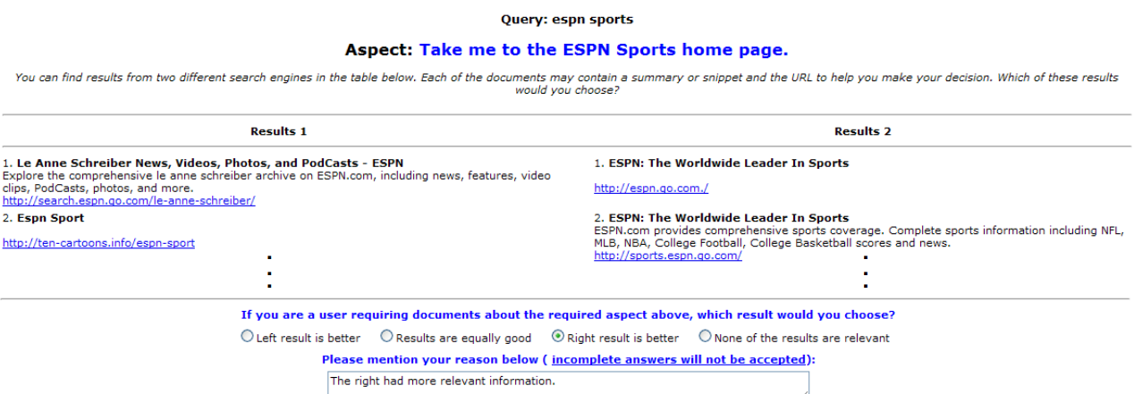
Experiment settings
IR systems
19 runs of submissions to the TREC evaluation
Users need to make side-by-side comparison to give their preferences over the ranking results

Slide 7
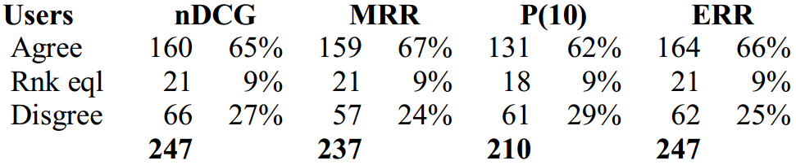
Experimental results
User preferences v.s., retrieval metrics
Metrics generally match users’ preferences, no significant differences between metrics

Slide 8
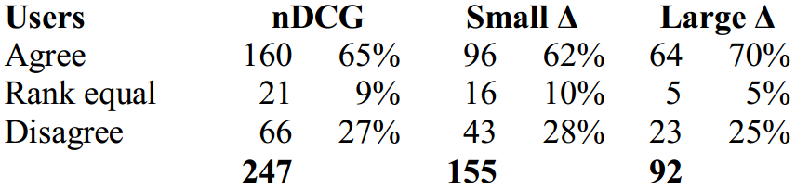
Experimental results
Zoom into nDCG
Separate the comparison into groups of small differences and large differences
Users tend to agree more when the difference between the ranking results is large
Compare to mean difference

Slide 9
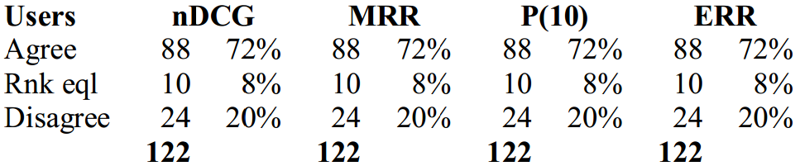
Experimental results
What if when one system did not retrieve anything relevant
All metrics tell the same and mostly align with the users

Slide 10
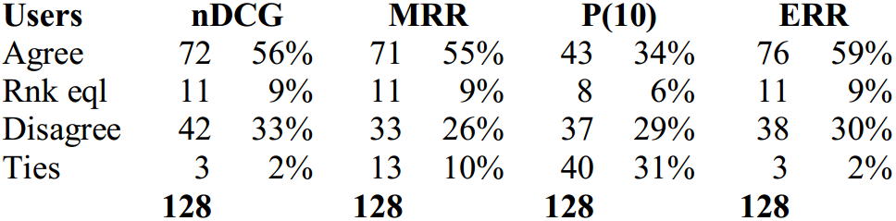
Experimental results
What if when both systems retrieved something relevant at top positions
P@10 cannot distinguish the difference between systems

Slide 11
Conclusions of this study
IR evaluation metrics measured on a test collection predicted user preferences for one IR system over another
The correlation is strong when the performance difference is large
Effectiveness of different metrics vary

Slide 12
How does clickthrough data reflect retrieval quality ^{[Radlinski CIKM’08]}
User behavior oriented retrieval evaluation
Low cost
Large scale
Natural usage context and utility
Common practice in modern search engine systems
A/B test

Slide 13
A/B test
Two-sample hypothesis testing
Two versions (A and B) are compared, which are identical except for one variation that might affect a user's behavior
E.g., indexing with or without stemming
Randomized experiment
Separate the population into equal size groups
10% random users for system A and 10% random users for system B
Null hypothesis: no difference between system A and B
Z-test, t-test

Slide 14
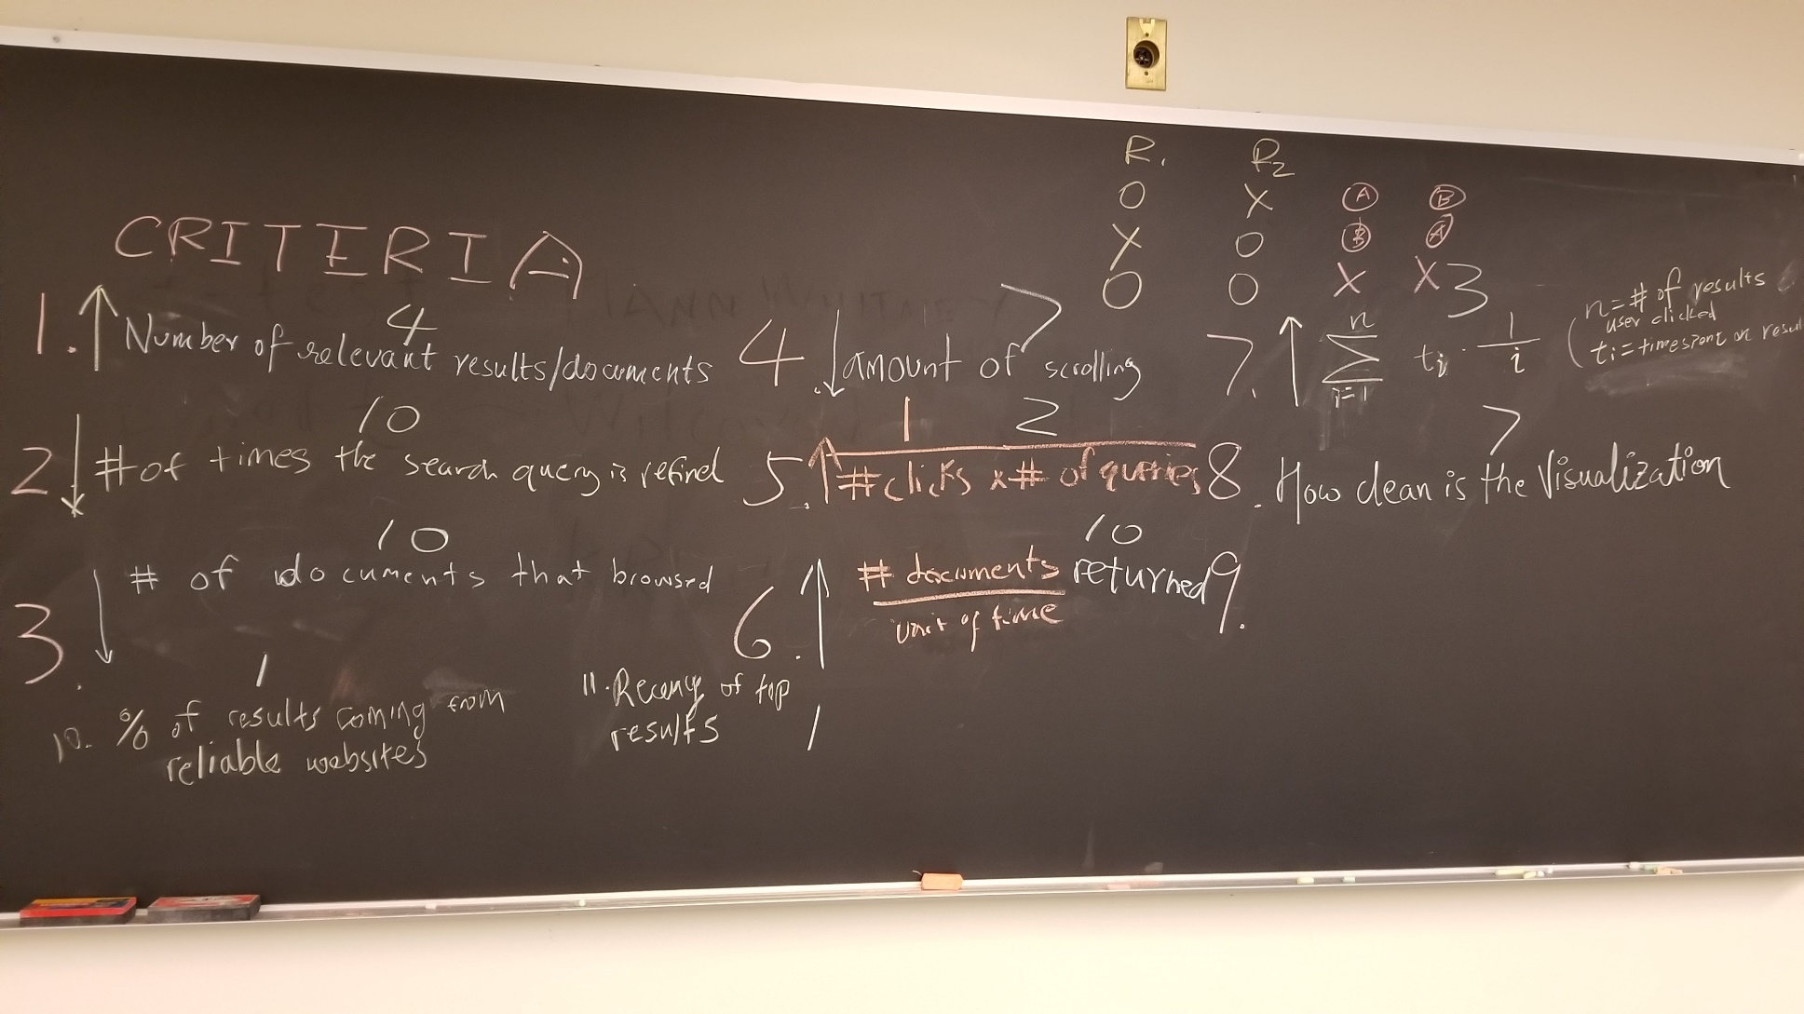
Behavior-based metrics

Slide 15
Behavior-based metrics
Abandonment Rate
Fraction of queries for which no results were clicked on
Reformulation Rate
Fraction of queries that were followed by another query during the same session
Queries per Session
Mean number of queries issued by a user during a session

Slide 16
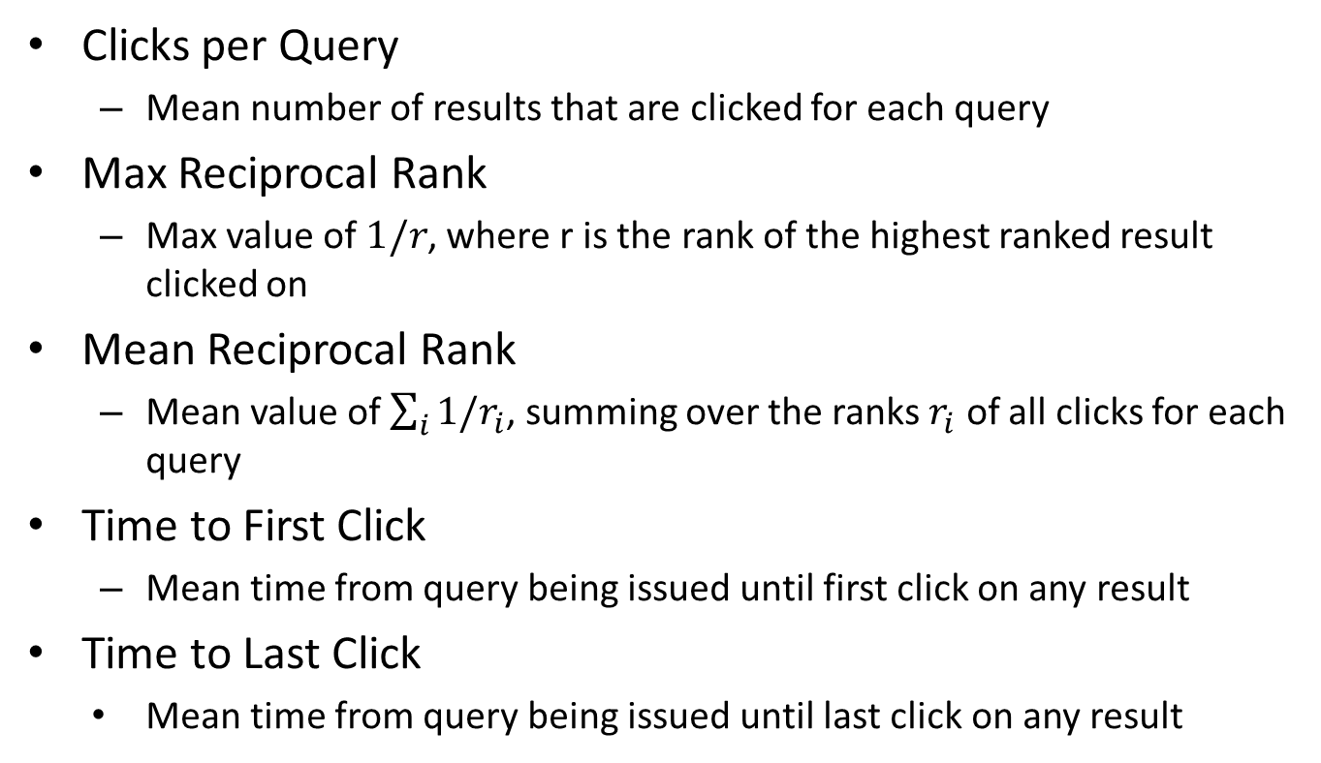
Behavior-based metrics
Clicks per Query
Mean number of results that are clicked for each query
Max Reciprocal Rank
Max value of $1/r$, where r is the rank of the highest ranked result clicked on
Mean Reciprocal Rank
Mean value of $\sum_{i}{1/r_{i}}$, summing over the ranks $r_{i}$ of all clicks for each query
Time to First Click
Mean time from query being issued until first click on any result
Time to Last Click
Mean time from query being issued until last click on any result

Slide 17
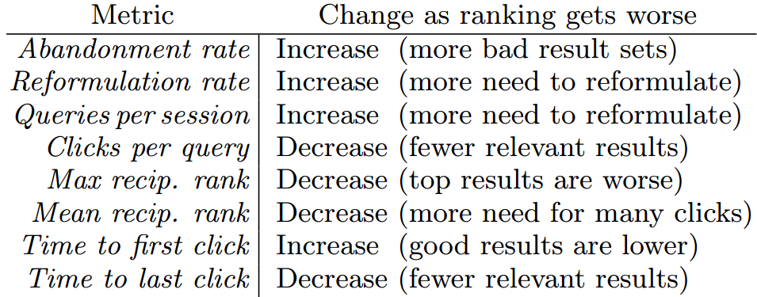
Behavior-based metrics
When search results become worse:

Slide 18
Experiment setup
Philosophy
Given systems with known relative ranking performance
Test which metric can recognize such difference
Reverse thinking of hypothesis testing
In hypothesis testing, we choose system by test statistics
In this study, we choose test statistics by systems

Slide 19
Constructing comparison systems
Orig > Flat > Rand
Orig: original ranking algorithm from arXiv.org
Flat: remove structure features (known to be important) in original ranking algorithm
Rand: random shuffle of Flat’s results
Orig > Swap2 > Swap4
Swap2: randomly selects two documents from top 5 and swaps them with two random documents from rank 6 through 10 (the same for next page)
Swap4: similar to Swap2, but select four documents for swap

Slide 20
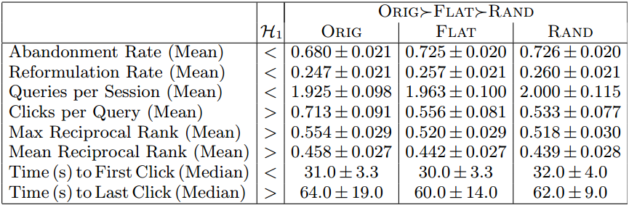
Result for A/B test
1/6 users of arXiv.org are routed to each of the testing systems in one month period

Slide 21
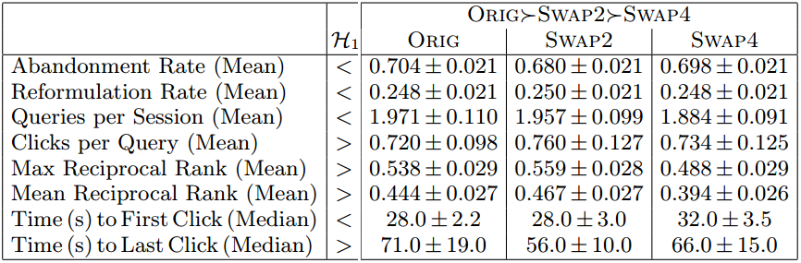
Result for A/B test
1/6 users of arXiv.org are routed to each of the testing systems in one month period

Slide 22
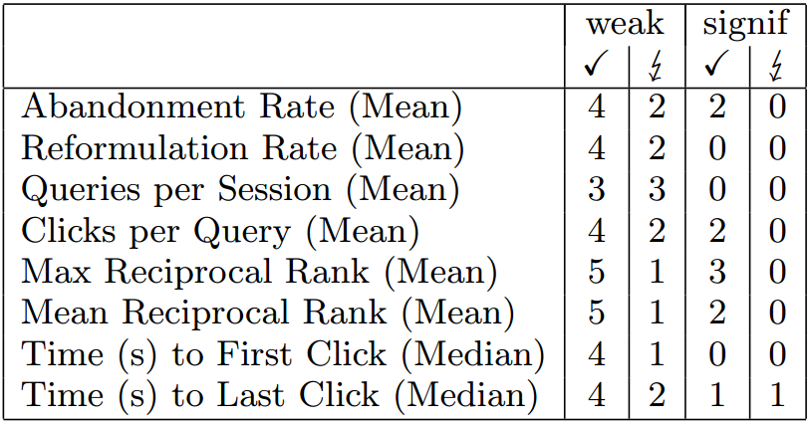
Result for A/B test
Few of such comparisons are significant

Slide 23
Interleave test
Design principle from sensory analysis
Instead of asking for absolute ratings, ask for relative comparison between alternatives
E.g., is A better than B?
Randomized experiment
Interleave results from both A and B
Giving interleaved results to the same population and ask for their preference
Hypothesis test over preference votes

Slide 24
Coke v.s. Pepsi
Market research
Do customers prefer coke over pepsi, or they do not have any preference
Option 1: A/B Testing
Randomly find two groups of customers and give coke to one group and pepsi to another, and ask them if they like the given beverage
Option 2: Interleaved test
Randomly find a group of users and give them both coke and pepsi, and ask them which one they prefer

Slide 25
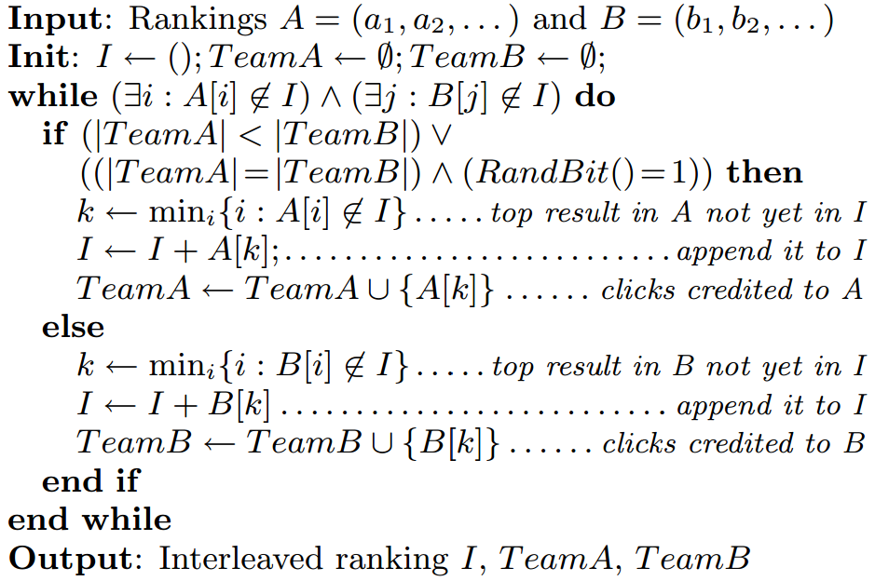
Interleave for IR evaluation
Team-draft interleaving

Slide 26
Interleave for IR evaluation
Team-draft interleaving
Ranking A:
2
3
1
4
5
7
8
6
Ranking B:
1
2
5
3
6
8
7
4
1
1
RND =
0
Interleaved ranking
1
2
3
5
4
6

Slide 27
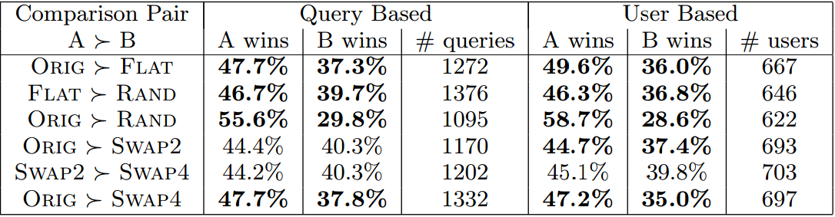
Result for interleaved test
1/6 users of arXiv.org are routed to each of the testing systems in a one month period
Test which group receives more clicks

Slide 28
Conclusions
Interleaved test is more accurate and sensitive
9 out of 12 experiments follow our expectation
Only click count is utilized in this interleaved test
More aspects can be evaluated
E.g., dwell-time, reciprocal rank, if leads to download, is last click, is first click
Interleave more than two systems for comparison

Slide 29
Comparing the sensitivity of information retrieval metrics [Radlinski & Craswell, SIGIR’10]
How sensitive are those IR evaluation metrics?
How many queries do we need to get a confident comparison result?
How quickly it can recognize the difference between different IR systems?

Slide 30
Experiment setup
IR systems with known search effectiveness
Large set of annotated corpus
12k queries
Each retrieved document is labeled into 5-grade level
Large collection of real users’ clicks from a major commercial search engine
Approach
Gradually increase evaluation query size to investigate the conclusion of metrics

Slide 31
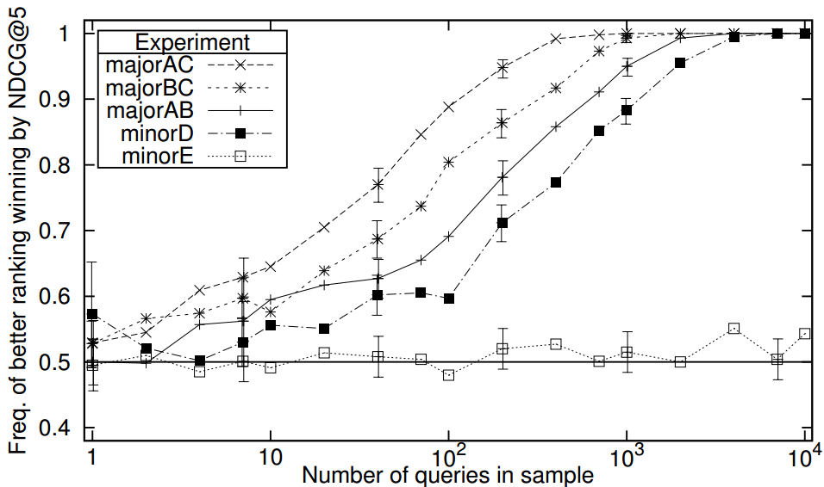
Sensitivity of NDCG@5
System effectiveness: A>B>C

Slide 32
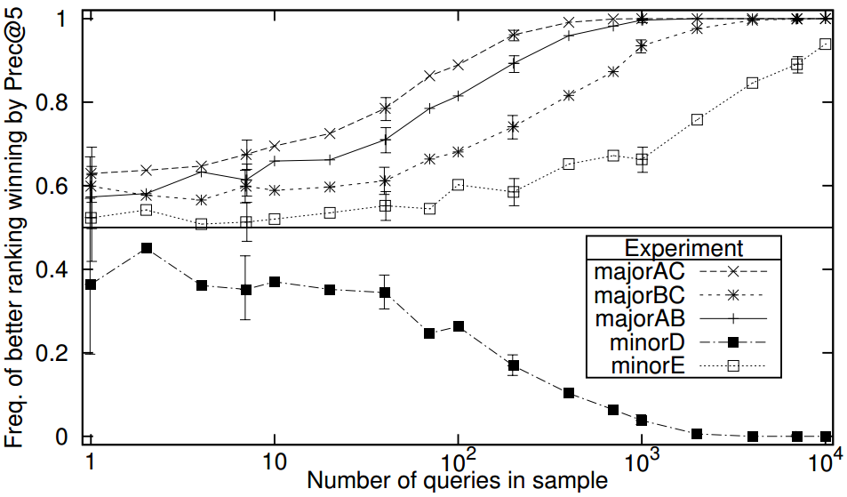
Sensitivity of P@5
System effectiveness: A>B>C

Slide 33
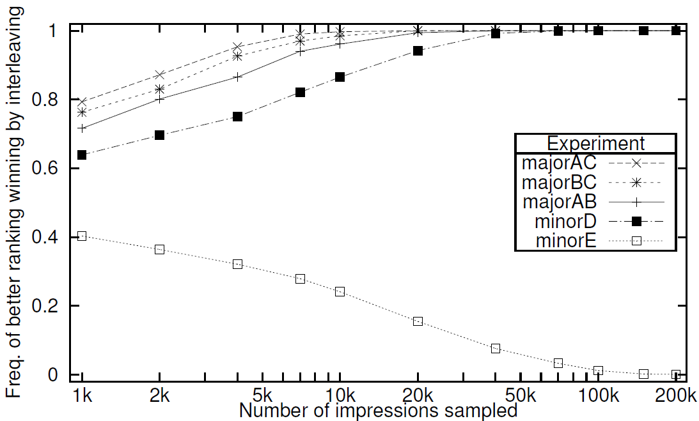
Sensitivity of interleaving

Slide 34
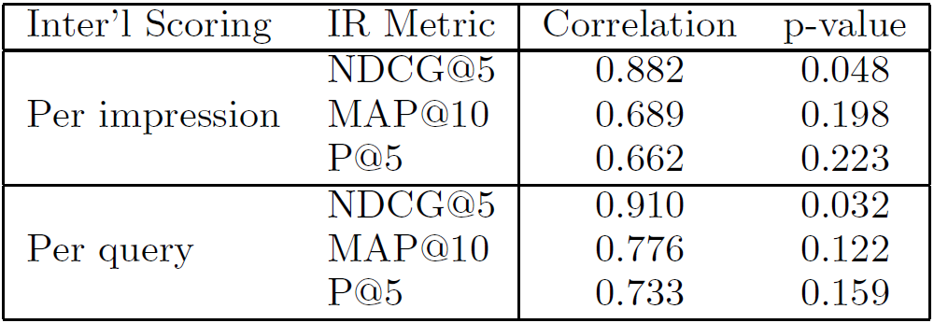
Correlation between IR metrics and interleaving

Slide 35
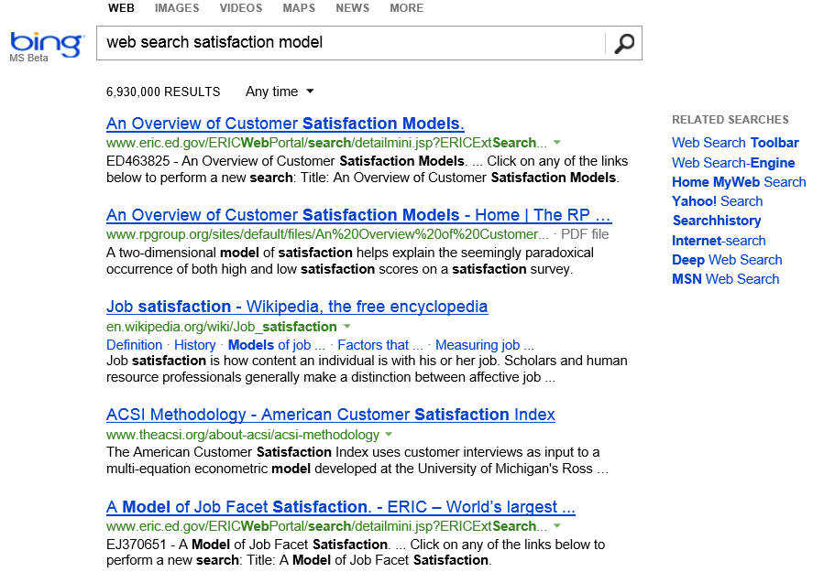
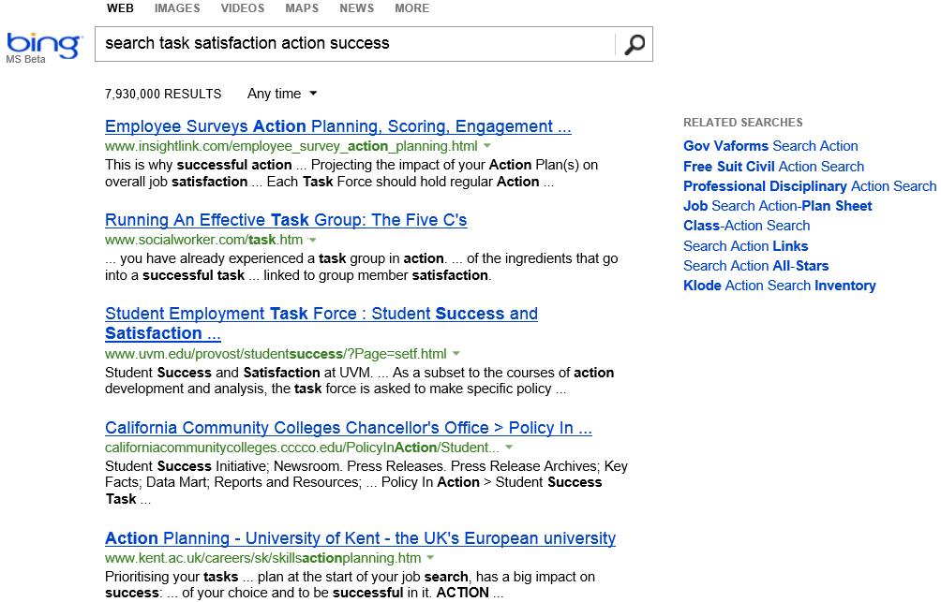
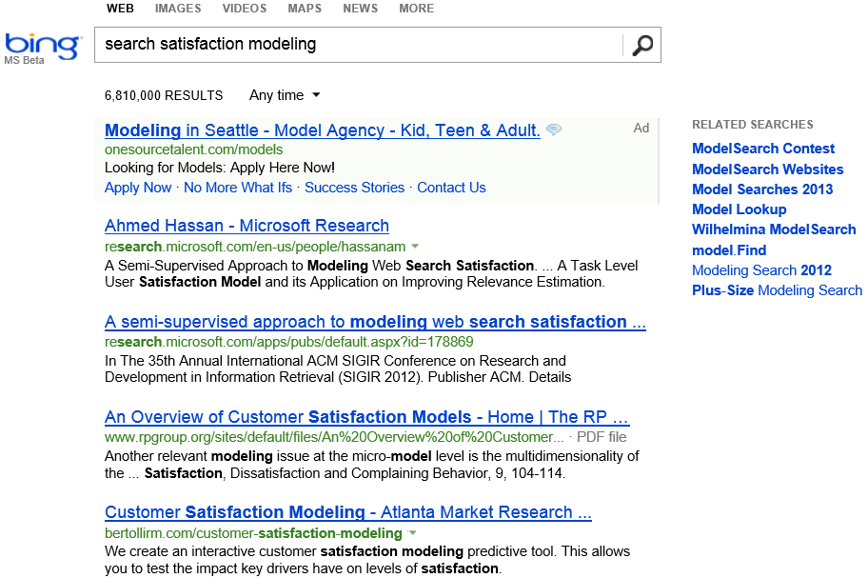





How to assess search result quality?
Query-level relevance evaluation
Metrics: MAP, NDCG, MRR, CTR
Task-level satisfaction evaluation
Users’ satisfaction of the whole search task
Goal: find existing work for “action-level search satisfaction prediction”
Notes:
Accurately assessing users' satisfaction of a search engine's output is of particular importance in retrieval system development. Classical IR studies focus on query-based evaluations, where the focus is to evaluate the relevance quality of the returned documents for a given query.
However, such query-centric evaluation can hardly capture the holistic utility of a search engine in supporting the users to perform a complex search task, e.g., survey a research topic, where a series of queries have to be issued to fulfill the same information need.
Measuring search engine performance via behavioral indicators of search satisfaction has recently received considerable attention. In comparison with traditional relevance-based evaluations, such methods enable evaluation using real user populations, in naturalistic settings, and across a diverse set of information needs.

Slide 36
Example of search task
Information need: find out what metal can float on water
Search Actions | Engine | Time
Q: metals float on water | Google | 10s
SR: wiki.answers.com |  | 2s
BR: blog.sciseek.com |  | 3s
Q: which metals float on water | Google | 31s
Q: metals floating on water | Google | 16s
SR: www.blurtit.com |  | 5s
Q: metals floating on water | Bing | 53s
Q: lithium sodium potassium float on water | Google | 38s
SR: www.docbrown.info |  | 15s
quick back
query reformulation
search engine switch

Slide 37
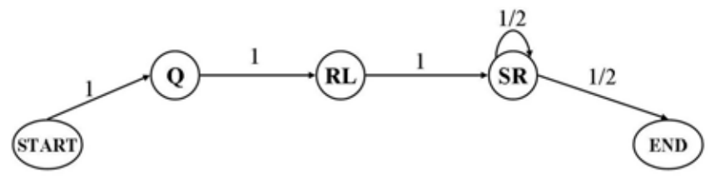
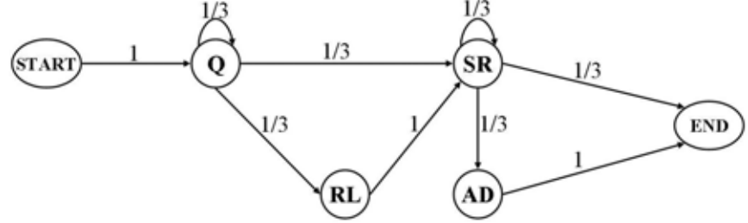
Beyond DCG: User Behavior as a Predictor of a Successful Search ^{[Ahmed et al. WSDM’10]}
Modeling users’ sequential search behaviors with Markov models
A model for successful search patterns
A model for unsuccessful search patterns
ML for parameter estimation on annotated data set

Slide 38
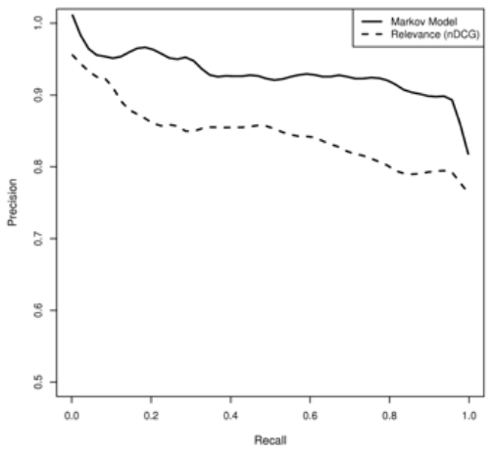

Predict user satisfaction
Choose the model that better explains users’ search behavior
$P\left(S=1 | B\right)=\frac{P\left(B | S=1\right)p\left(S=1\right)}{P\left(B | S=1\right)p\left(S=1\right)+P\left(B | S=0\right)p\left(S=0\right)}$
Likelihood: how well the model explains users’ behavior
Prior: difficulty of this task, or users’ expertise of search
Prediction performance for search task satisfaction

Slide 39
What you should know
IR evaluation metrics generally align with users’ result preferences
A/B test v.s. interleaved test
Sensitivity of evaluation metrics
Direct evaluation of search satisfaction

